Slide 1
Good Governance in Parochial Ministry
You couldn’t make it up!
Session 2
Church Representation Rules
and the Churchwardens’ Measure
Notes:
Norman

Slide 2
Key legislation
Parochial Church Councils (Powers) Measure 1956 defines functions and powers of PCCs
Synodical Government Measure 1969 schedule 3 (Church Representation Rules)
Churchwardens’ Measure 2001

Slide 3
Role of PCC
PCC a body corporate
PCC a charitable body
PCC solely to promote charitable objects, not for different public or private purposes
To co-operate with the incumbent in promoting in the ecclesiastical parish the whole mission of the Church, pastoral, evangelistic, social and ecumenical.

Slide 4
Church Representation Rules
Electoral Roll – basis of church governance
Roll is drawn up from scratch every six years and revised annually in the intervening years.
May include email addresses
GDPR issues - published roll must include names only (Rule 1 (13)) although other details are stored on full roll
PCC decides how roll to be published – whether electronic or otherwise (Rule 8 (1))

Slide 5
Church Representation Rules
Annual Parochial Church Meeting
Must be held by 31 May
PCC reports on the mission and activities of the previous year, including statement of accounts.
Elects representatives to Deanery Synod (every three years unless a vacancy occurs)
Elects members of the Parochial Church Council (usually a third of members stand down every year but can be re-elected if still eligible)
Appoints auditor / independent examiner
PCC decides on venue and timing of APCM
Does not appoint sidesmen.

Slide 6
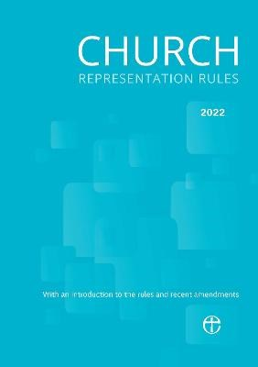
Church Representation Rules
Parochial Church Council
CRR governs membership and lays down all procedures
Chair, Vice Chair and other cleric authorised to chair
District Church Councils
BMOs are part of Deanery
(Mission Initiative Roll 27A – D)
Provision for when not enough on
PCC or no officers

Slide 7
Church Representation Rules
Key points:
Model rules apply to all PCCs but individual PCCs may apply to vary these. Rule 12 & 13
PCC must hold a sufficient number of meetings to transact its business Rule M23 (1)
Chair may decide to conduct business by correspondence Rule M29
PCCs in multi-parish benefices and group ministries may put in place a scheme to meet as a Joint Council Rules M37 – M42
Lay members of the PCC must always be in a majority Rule M13 (2) & M27 (2)

Slide 8
Churchwardens Measure 2001
Churchwardens elected at Annual Meeting of Parishioners
AMP to be held before 31st May each year
open to those on local government electoral roll who live in parish.
Who is disqualified?
All nominations made before the meeting starts
Can someone stand if not an Anglican?
PCC membership
Churchwardens only allowed to serve for six consecutive years, unless..
Bishop’s waiver of qualifications for Churchwardens

Slide 9
Three recent useful changes
What can be done when there are few/no PCC members and the bishop’s powers to make directions?
The new Joint Council provisions and how these work in practice – these are becoming quite popular where it is difficult to populate PCCs.
What can be done when a parish is struggling to find churchwardens – bishop’s power to waive certain of the qualification requirements.

