Slide 1
Getting married: the origins of the current law and problems
Professor Rebecca Probert
University of Exeter

Slide 2
The making of the Marriage Act 1836
The way in which the campaign for reform was framed
The continuing concern about the risk of clandestine marriage
The desire of the Whig government to implement the New Poor Law across the entirety of England and Wales

Slide 3
The concerns about clandestinity
Clandestine Marriages Act 1753
Marriage Act 1823
The need for some system of advance notice
The need for registration

Slide 4
The campaign against compulsory conformity
The request to be able to omit references to the Trinity
Focus on the right not to have to marry in a way that violated one’s conscience
Prioritised finding an alternative above the form of that alternative

Slide 5
The existing exemptions: an ambiguous and unhelpful precedent
The 1753 and 1823 Acts had exempted Quakers and Jews but said nothing about how their marriages were to be regulated or even whether they were valid
Courts had held that the validity of Jewish marriages was to be tested according to Jewish law

Slide 6
The idea of marrying in licensed places of worship
The system of licensing had its roots in suspicion of those who did not conform to the Established Church
Concern about the types of places where non-Anglicans might be able to marry

Slide 7
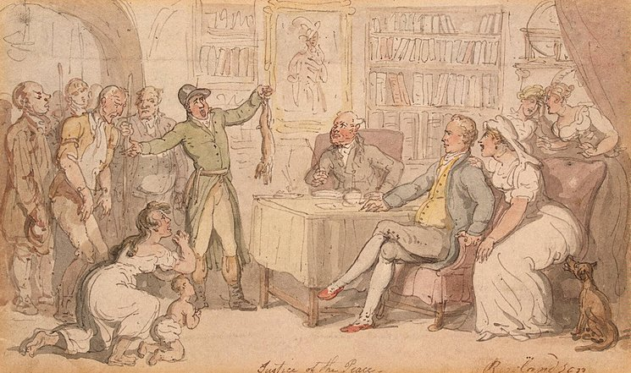
The idea of marrying before a magistrate
Idea of marriage as a civil contract
Idea of marriages being made in the presence of a representative of the state

Slide 8
The idea OF civil registration
Dissenters were were united in their desire for a new system of civil registration of births and deaths as well as of marriages

Slide 9
the machinery of new poor law
New system of civil preliminaries
Marriages to take place in registered places of worship in the presence of a registrar
Registrar was responsible for registration
Alternative option of marrying in the office of the superintendent registrar

Slide 10
Convenience or political expediency?
New Poor Law was not actually in force
Roles of superintendent registrar and registrars did not exist
Pretext to press ahead with implementation
Resulted in opposition and riots

Slide 11
Evaluating the 1836 Act
Ensured that no one would be compelled to marry in a way that was contrary to their conscience by minimising regulation of the ceremony
Did not reflect the way in which many Dissenters wanted to marry
Inability to implement the New Poor Law everywhere necessitated various temporary expedients
Very far from being a coherent codification of the laws governing marriage

Slide 12
The take-up of the 1836 Act
Catholics were more likely to register their places of worship for marriage and to get married there than Protestant Dissenters
Register office weddings did not represent a rejection of religion

Slide 13
Reacting to problems: the reforms of the 1850s
Places of Worship Act 1855 allowed non-Christian places of worship to be certified and registered
Marriage and Registration Act 1856
amended the requirements for civil preliminaries
recalibrated the roles of the state and the church in the making of marriage

Slide 14
Remarriage
Prosecutions were brought against two Anglican clergymen
New clause permitted a religious ceremony after a register office wedding
Implication that it was not possible to have a second religious ceremony after a wedding in a registered place of worship
New prohibition on a religious service in register office weddings

Slide 15
Divisions within dissent as to who should register marriages
Equal
Or Free?
Equality with the Established Church
Status
Automatic authorization of ministers to conduct weddings
Rejection of the idea of centralised control
No ordained ministry
Reluctance to become agents of the state

Slide 16
Differing models as to how marriages would be registered
Prior authorization
Whoever had officiated
issue register books to specific authorised ministers who would conduct and register marriages
require the person officiating at the marriage to complete certain prescribed documentation confirming that the marriage had taken place and return it to the superintendent registrar

Slide 17
Marriage Act 1898
The appointment of ‘authorised persons’
Passive role – to be present, and to register the marriage
Only places of worship that could have been registered under the 1836 Act could appoint an authorised person

Slide 18
Marriage law in the c20th
Escalating complexity:
Church of England Marriage Measures
Mistakes and misunderstandings:
The passage of validating legislation

Slide 19
Consolidating complexity: marriage Act 1949
Overemphasised the divisions between different routes into marriage
Obscured how tightly regulated Quaker and Jewish marriages were
Allowed all places of worship to appoint their own authorised persons

Slide 20
Marriage law and practice since 1949
Minor changes to the law
Major changes in how couples marry
Increase in civil weddings, particularly on ‘approved premises’ after 1994

Slide 21
conclusion
Many of the problems with the current law are of long standing
The longevity of a particular requirement does not mean that it was introduced for a good reason, or has worked well
None of the reforms to date have addressed weddings law as a whole

